Slide 1
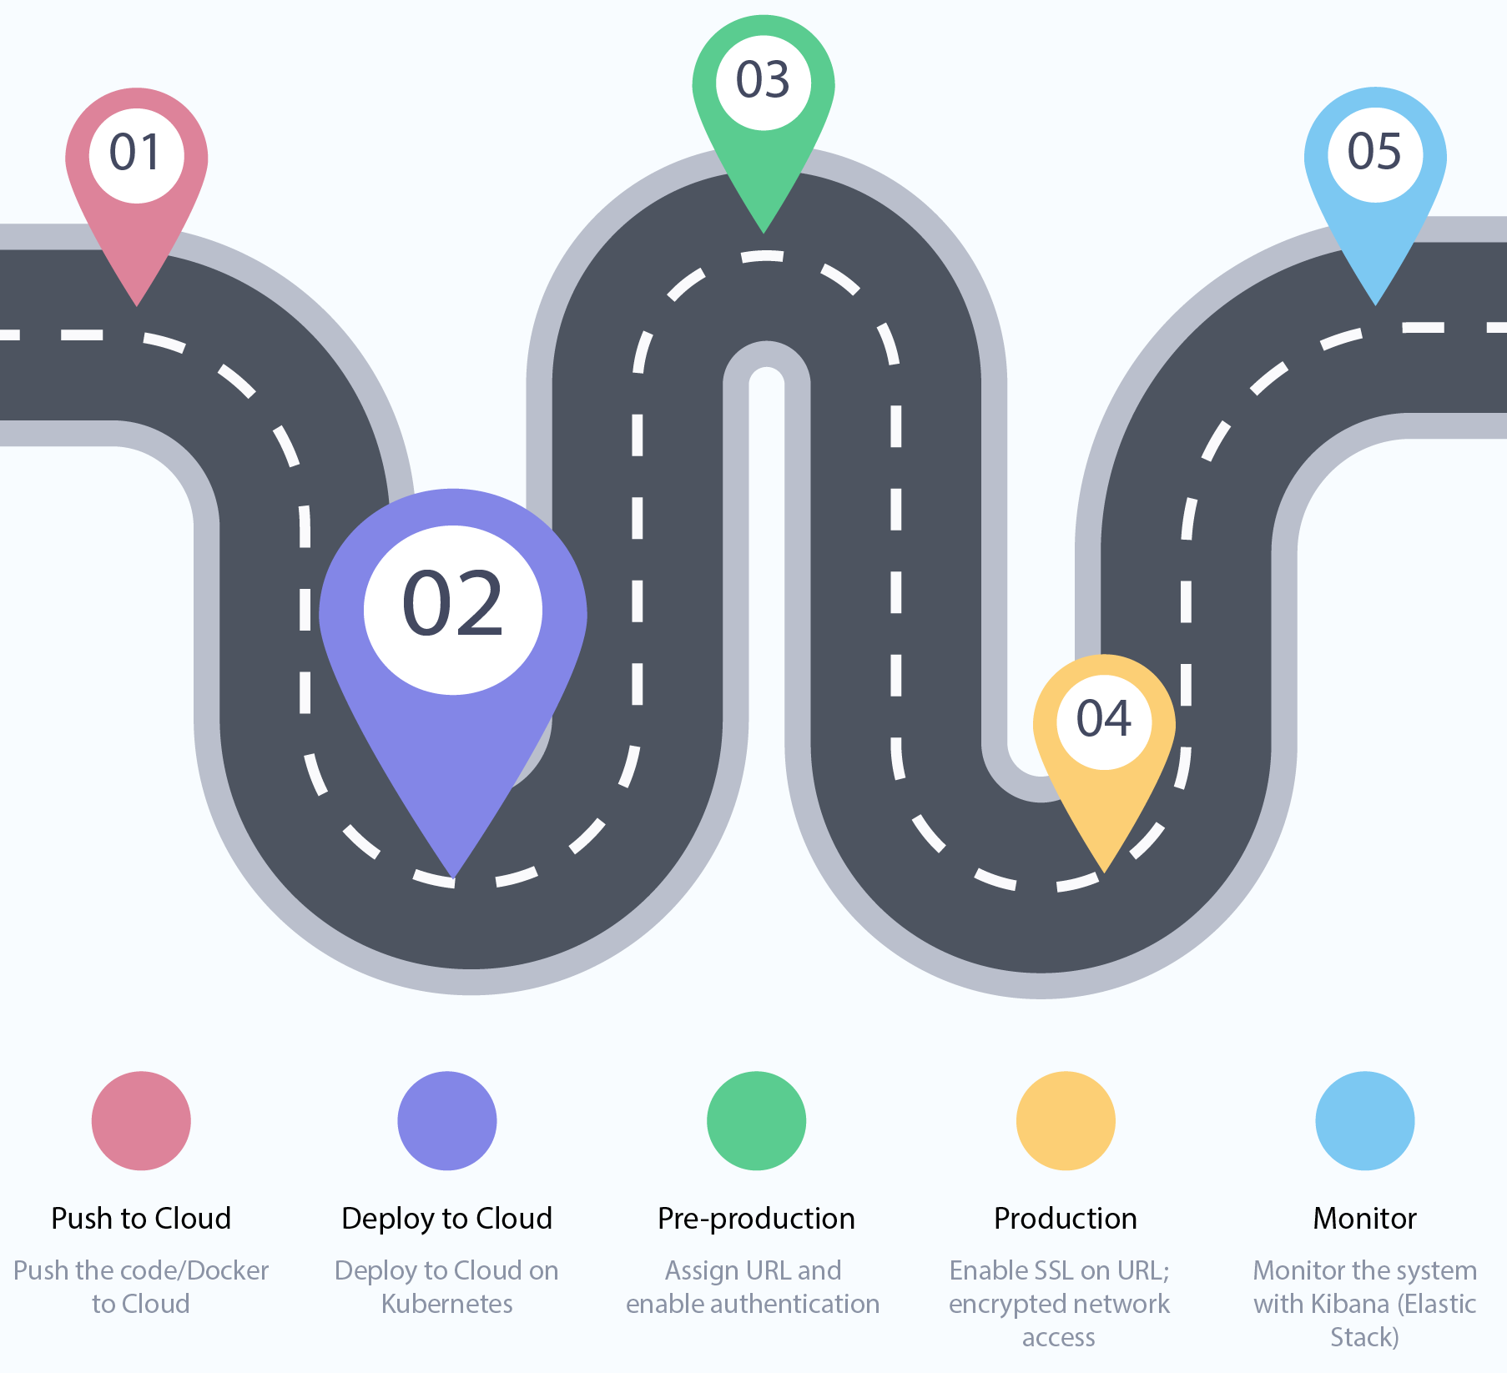

Slide 2
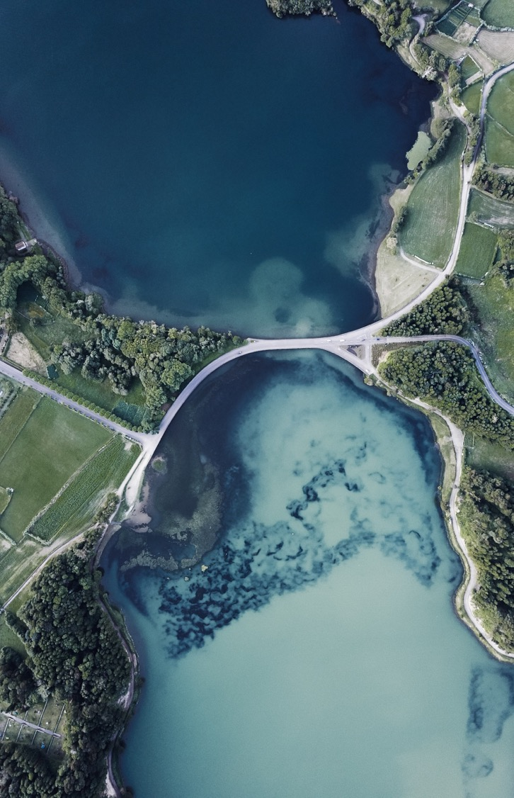
Intro to Kubernetes
A course in history

Slide 3
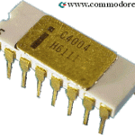
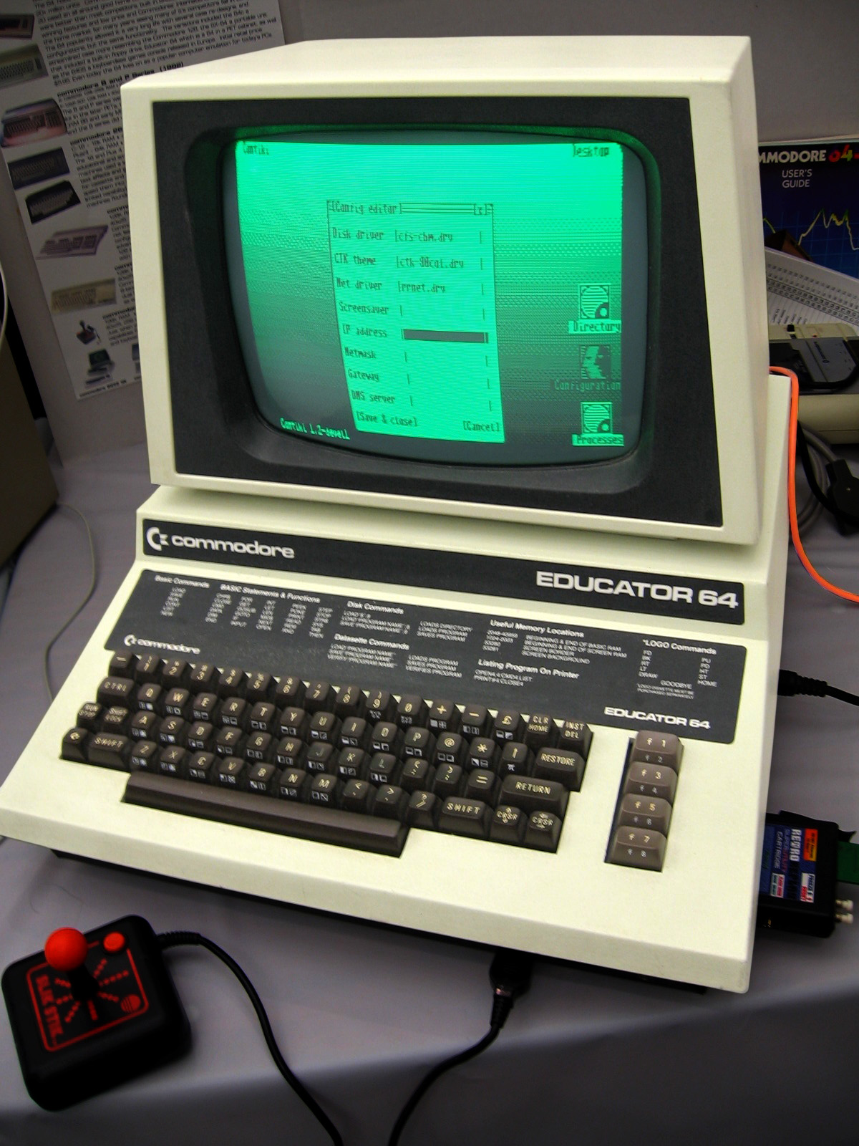
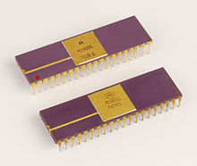
All started from local machine
All code starts from developers machine, so it makes sense to run it in the same place with the same HARDWARE.
Hardware was the PLATFORM to run software.
Image: Thomas Watson with ibm 701

Slide 4
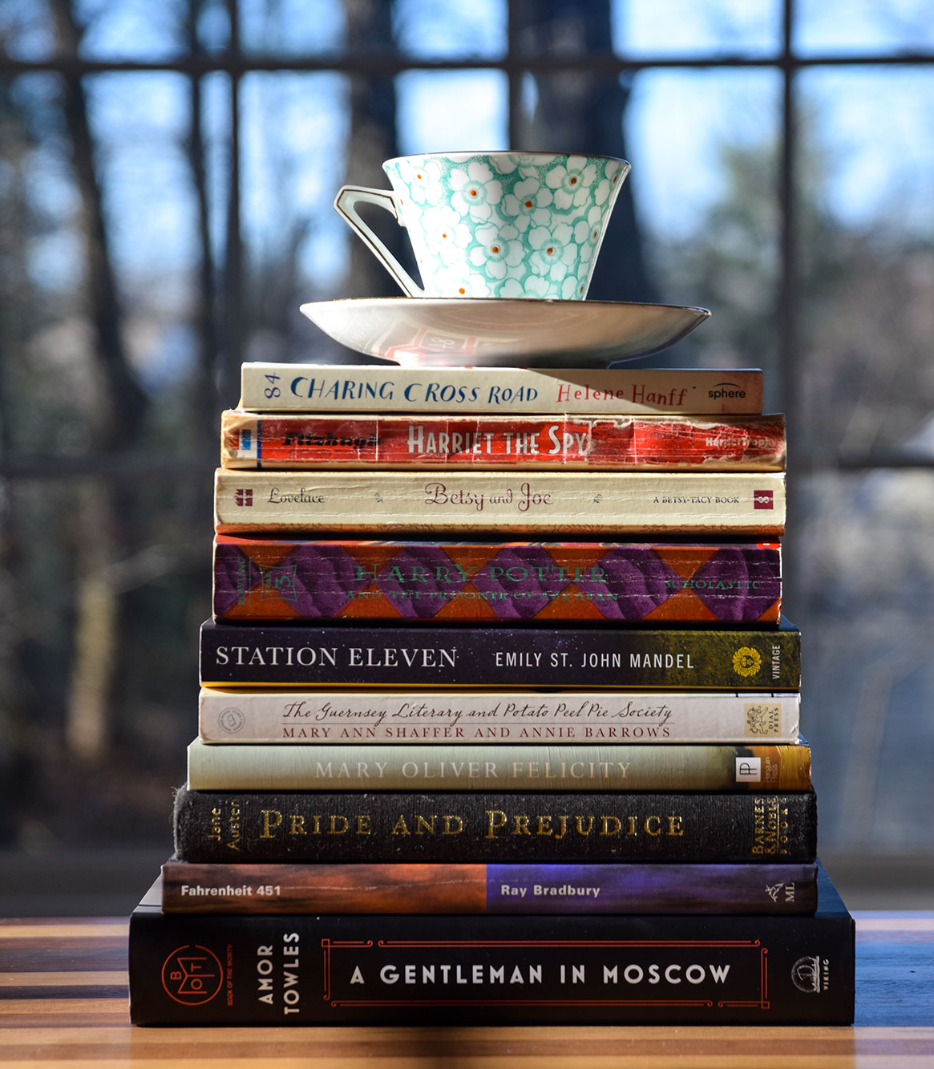
Technology stack
App
Hardware
Your company name

Slide 5
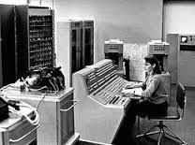
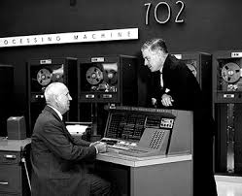
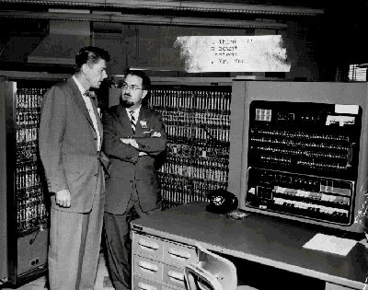
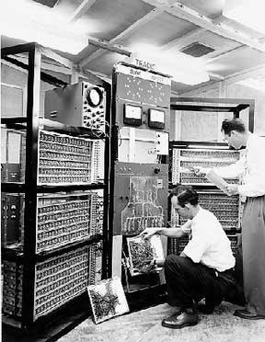
More computers? Different hardware?
Operating systems like Windows Server, Linux, … helped in having a good base for running software.
We can say operating systems became the new PLATFORM.

Slide 6
Technology stack
App
Hardware
OS
Your company name

Slide 7
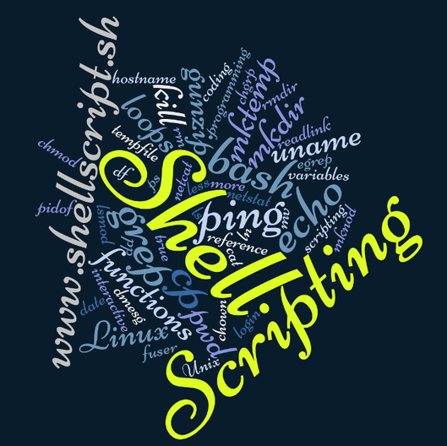
Lets have unified setup with …
Install the required software + configuration.
Your company name

Slide 8
Technology stack
App
Hardware
OS
Libs
Your company name

Slide 9
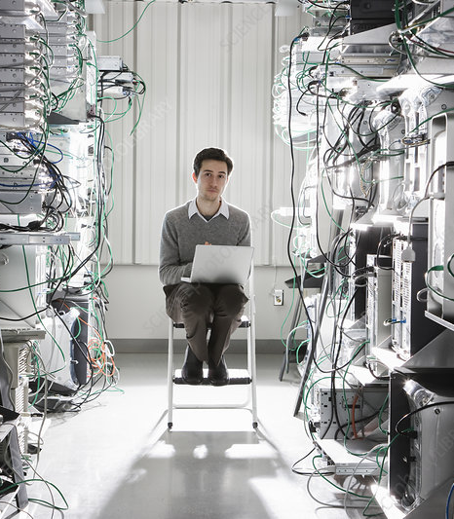

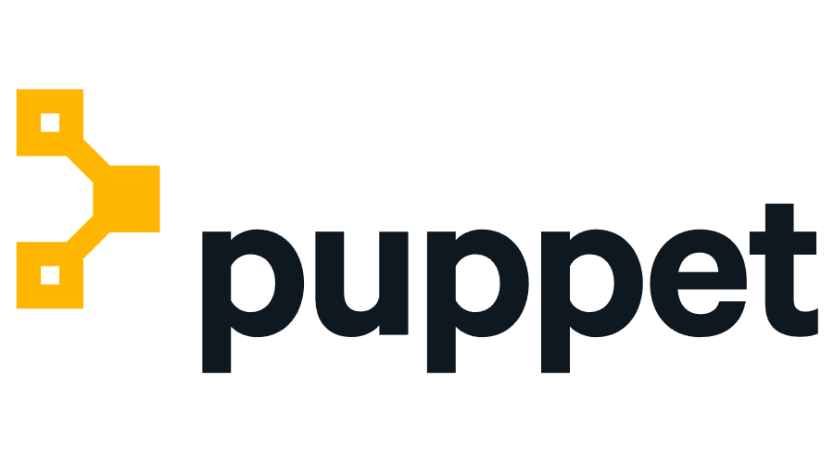
What if more servers?
Stream-lined scripting with different solutions.
Your company name

Slide 10
Technology stack
App
Hardware
OS
Libs
Your company name

Slide 11
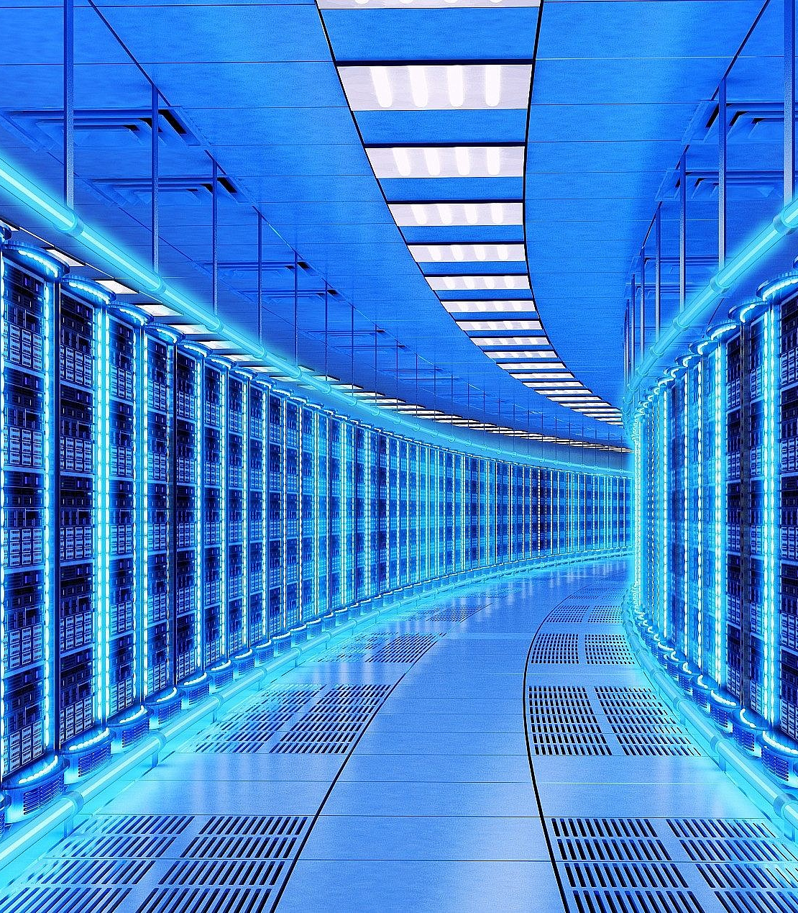
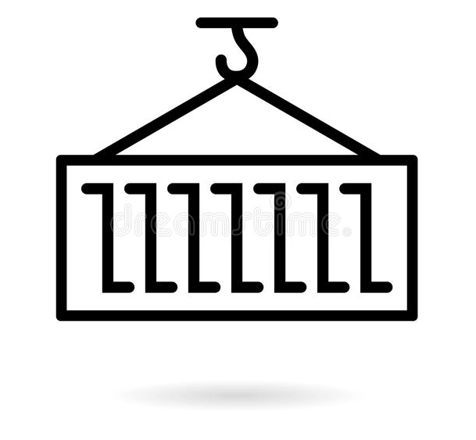
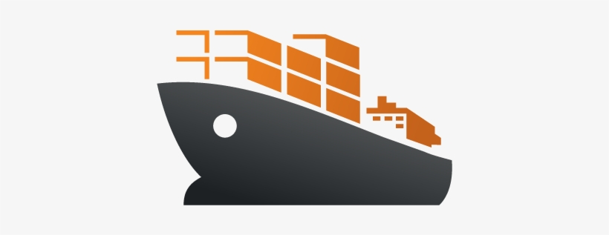
Still headache managing many varieties of operating systems
Your company name

Slide 12
Technology stack
App
Hardware
OS
Libs
Your company name

Slide 13
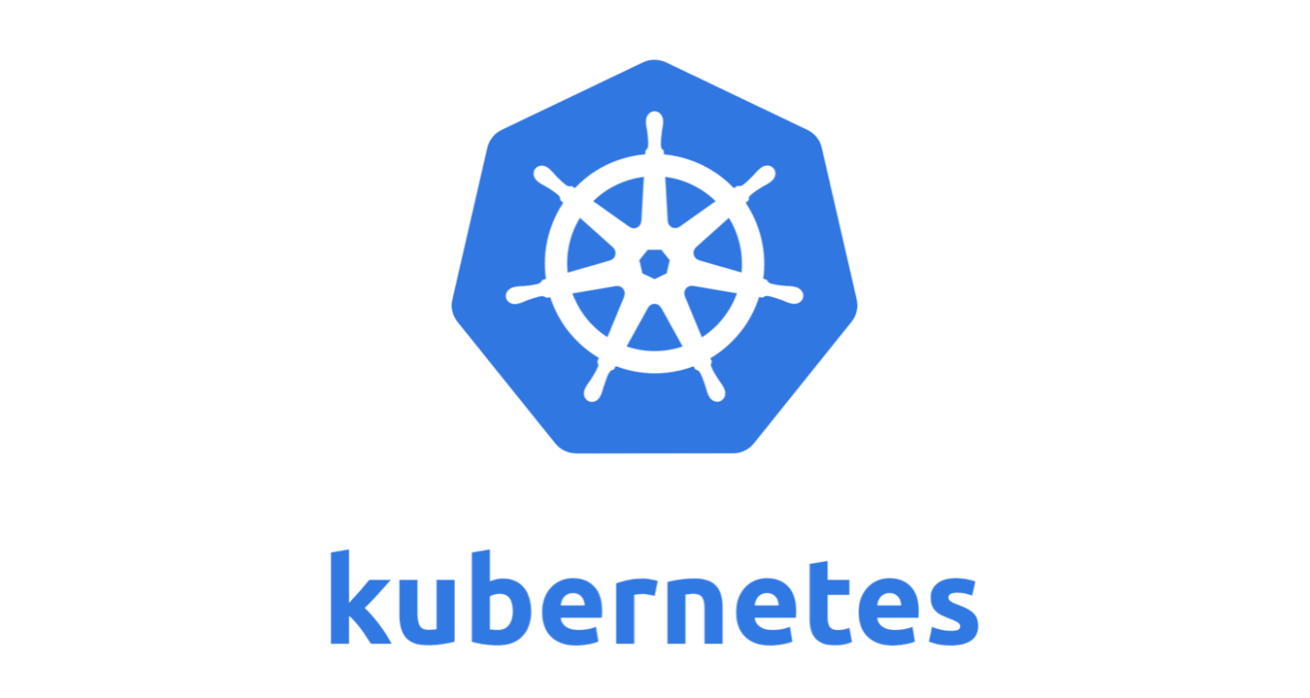
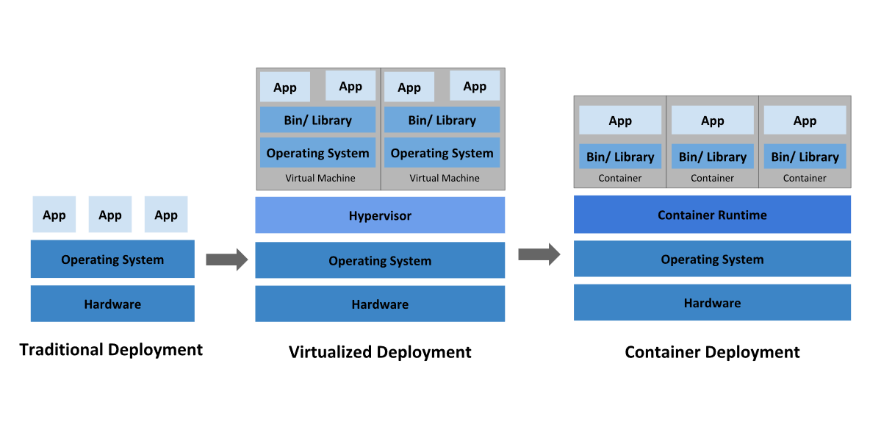
This technology made cloud possible

Slide 14
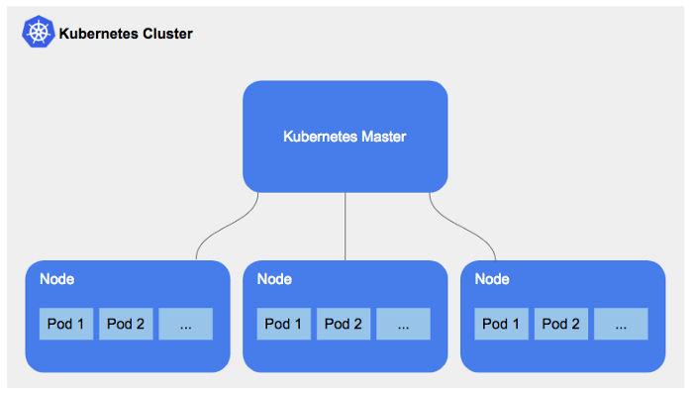
Your Docker image
will be here soon

Slide 15

Thank You
#training-code2cloud
Confluence > Site Reliability Engineering Space

